Slide 1
Portugal an opportunity
Data Science by IBM/Coursera
Cláudio Ferreira
19/10/2019

Slide 2
Invest in Portuguese Tourism
Due to the growth of the Portuguese economy to the increase of the tourist consumption and the incentive measures to the investment. Portugal has become very attractive for foreign investment groups.
Take note:
In 2018, Portugal received over 12 million foreign tourists,
Revenues in the sector increased 7.7% in Jan-Aug (2019), they represent more than 13% of PIB,.
In August 2019 Portugal received 3 308.7 guests, which generate an income of 630.1€ million for the sector.

Slide 3
Imagine that an investment group wants to invest in a successful business in Portugal.
They need to know
What kinds of businesses the cities already offer?
In which cities they could invest?
What kind of investment should the investment group make??

Slide 4
Data acquisition and cleaning
Info about Portuguese accommodations touristic in 2018, from Pordata, as index of most touristic cities.
Folium library was used to confirm the correct location and identification of each city on the Portugal map
Coded a Foursquare loop request based on table 1. The result was a total of 1779 venues, distributed for 178 venues categories.
Segmentation by K-Means clustering

Slide 5
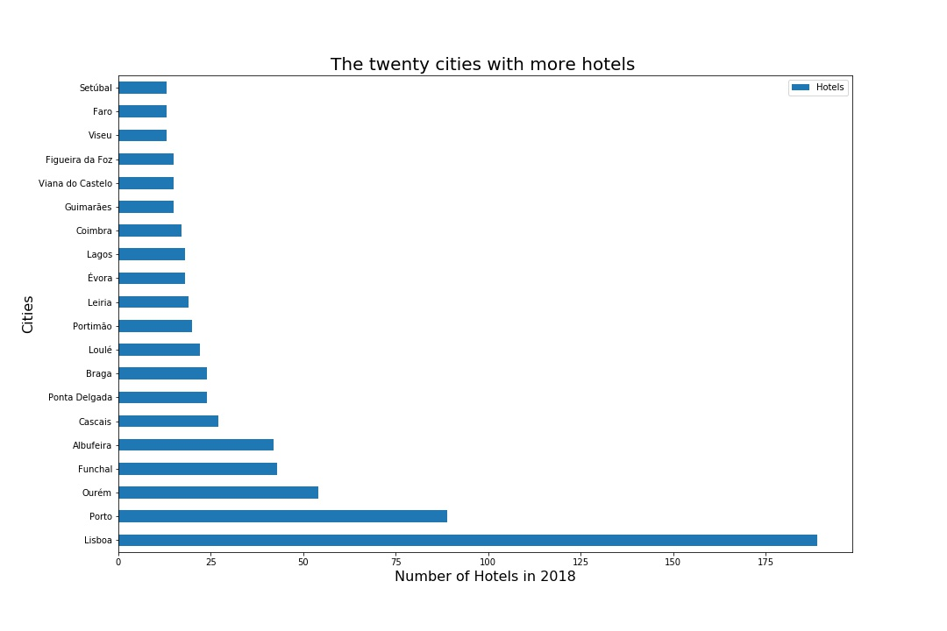
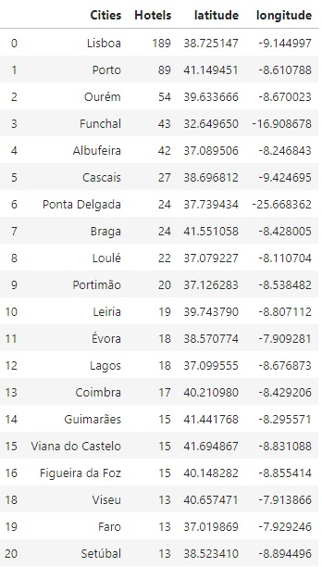
Cities with the higher tourism
Cities and coordinates

Slide 6
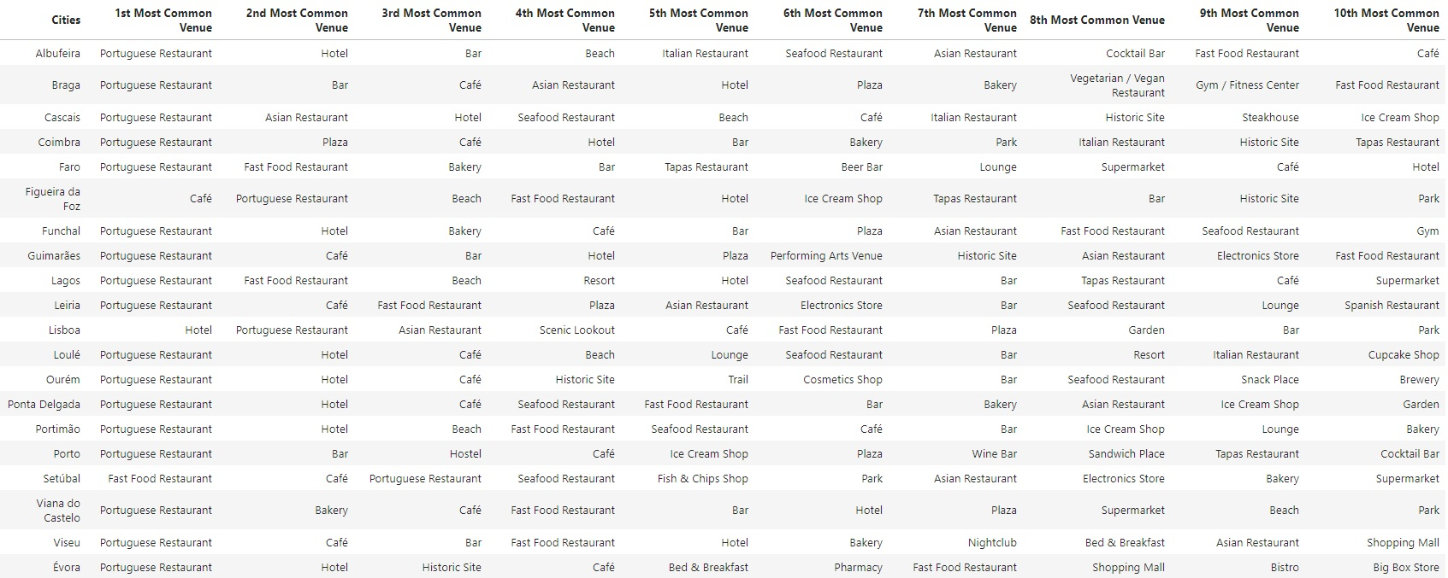
Most common venues

Slide 7
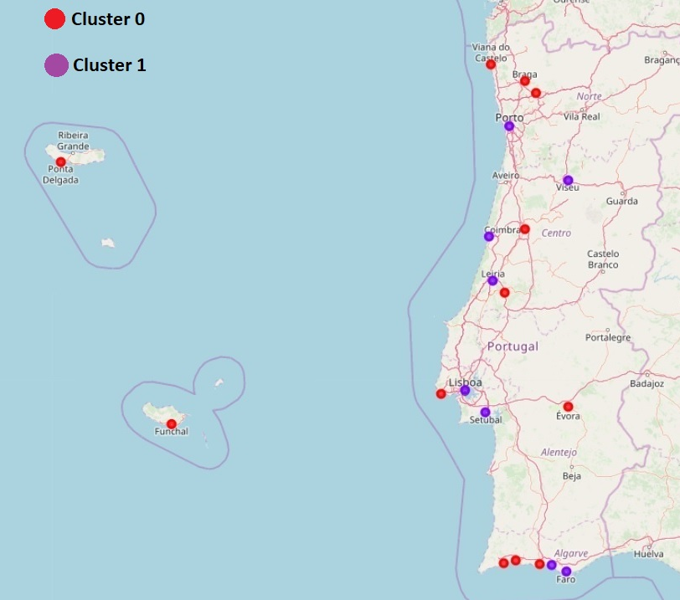
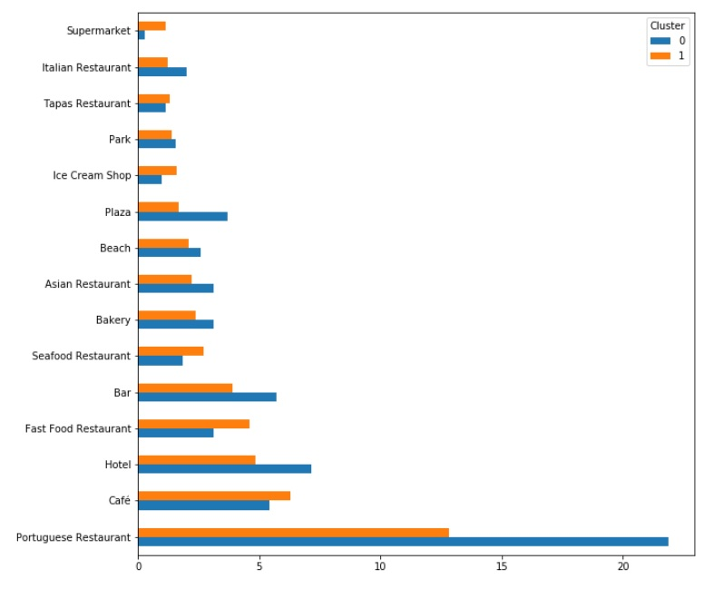
Exploring the Clusters
Average of most common venues per city
Map 1 – Representation of Cluster “0” and “1”

Slide 8
Conclusions
Machine learning techniques is useful help the decision making of an investor group.
It is necessary to find a platform with a database similar to Foursquare but with a larger number of Portuguese users more venues registered and updated.
Portuguese Restaurants are the most represented business in practically all cities.
Cities in cluster 1 have more potential to invest.
Venues found on average a lower number compared to cities in cluster 0 .
I recommend that the investment made in the construction of a hotel in the cities of Faro and especially Porto.

